Slide 1





US Used Cars Price Analysis
Professor:
Wang, Yang
Team Member:
Hsin-Yu Pan,
Ying-Hsuen Tsai,
Liwen Hou

Slide 2

Agenda
Business Problem
Explore Data Analysis
System Demo
Result & conclusion

Slide 3
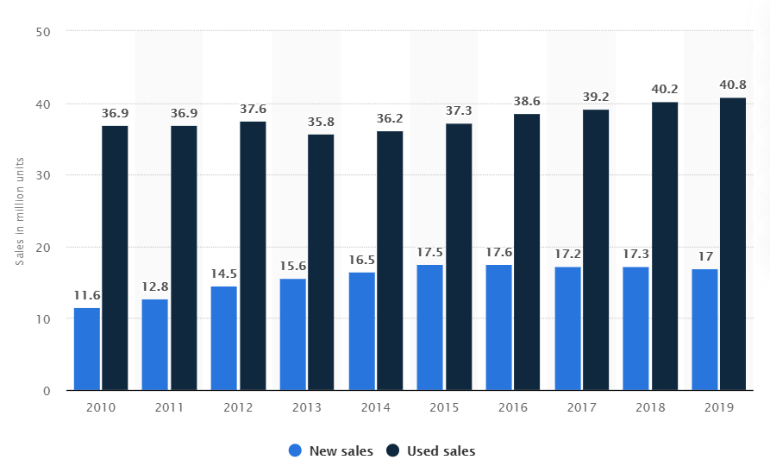
Background: Used vehicle sales in the US
A big, stable, largely countercyclical market
Used-car buyers differ from new-car buyers
Notes:
https://www.mckinsey.com/industries/automotive-and-assembly/our-insights/used-cars-new-platforms-accelerating-sales-in-a-digitally-disrupted-market

Slide 4



Business Problem
Help car dealers to understand the used-car price in the online market.
Notes:
As there is such a big used car market in the U.S., it is difficult for car dealers to decide prices for the used cars by themselves. Thus, car dealers may need a price recommendation system to help them with price setting.
To set competitive but also profitable prices for their products, the system needs to include adequate information about past transactions, which allows the system to find the baseline price for all different sorts of used vehicles.
Here, we will use Python to build the program.

Slide 5





Package we use

Slide 6
Agenda
Business Problem
Explore Data Analysis
System Demo
Result & conclusion

Slide 7
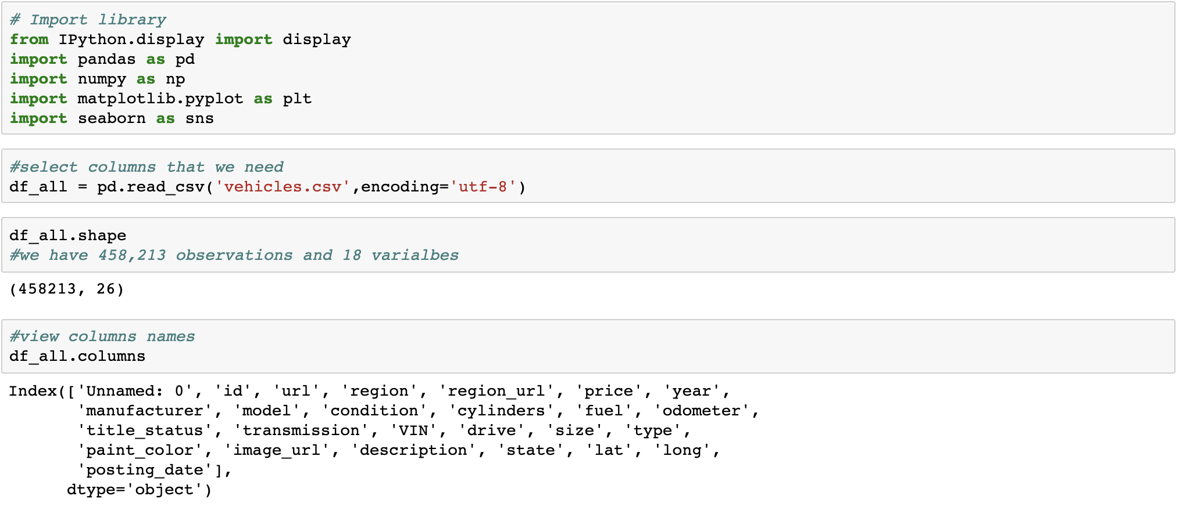
Loading Data into python
Notes:
This data is scraped every few months, it contains most all relevant information that Craigslist provides on car sales including columns like price, condition, manufacturer, latitude/longitude, and 18 other categories. For ML projects, consider feature engineering on location columns such as long/lat. For previous listings, check older versions of the dataset.
Ｄataset is form craglist

Slide 8
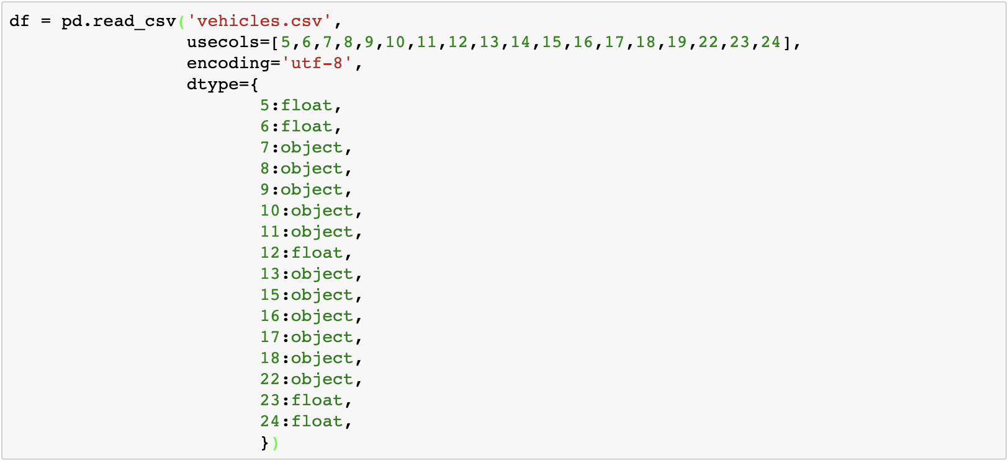
Select columns
Notes:
This data is scraped every few months, it contains most all relevant information that Craigslist provides on car sales including columns like price, condition, manufacturer, latitude/longitude, and 18 other categories. For ML projects, consider feature engineering on location columns such as long/lat. For previous listings, check older versions of the dataset.
Ｄataset is form craglist

Slide 9
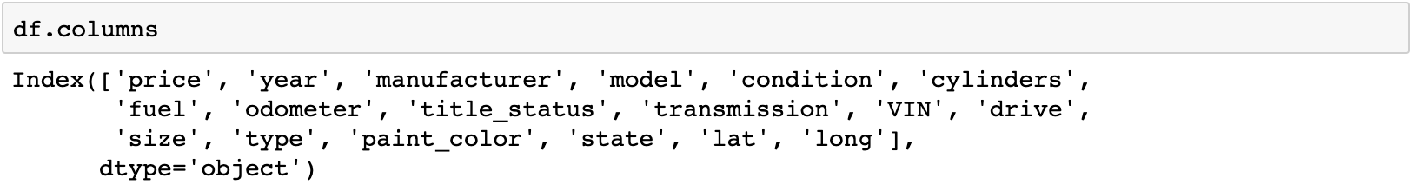
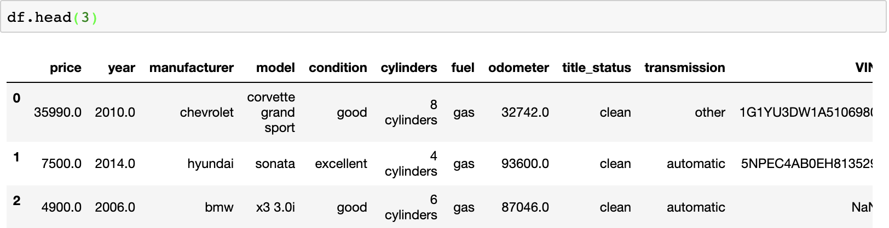
Read Data
Notes:
This data is scraped every few months, it contains most all relevant information that Craigslist provides on car sales including columns like price, condition, manufacturer, latitude/longitude, and 18 other categories. For ML projects, consider feature engineering on location columns such as long/lat. For previous listings, check older versions of the dataset.
Ｄataset is form craglist
1. 要不要提到18個attribute已經是我們篩選過的，一開始有更多（26個)
2. VIN 從頭到尾沒有用到或是提到，要拿掉嗎？

Slide 10
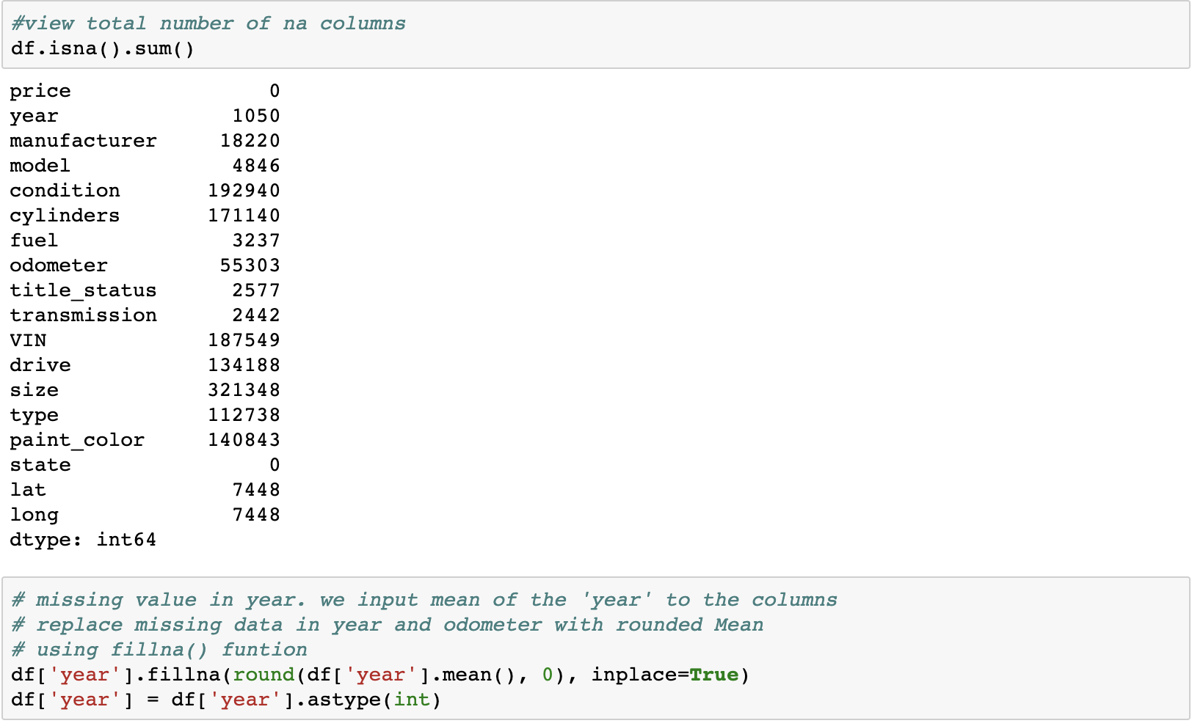
EDA – Filling missing value

Slide 11
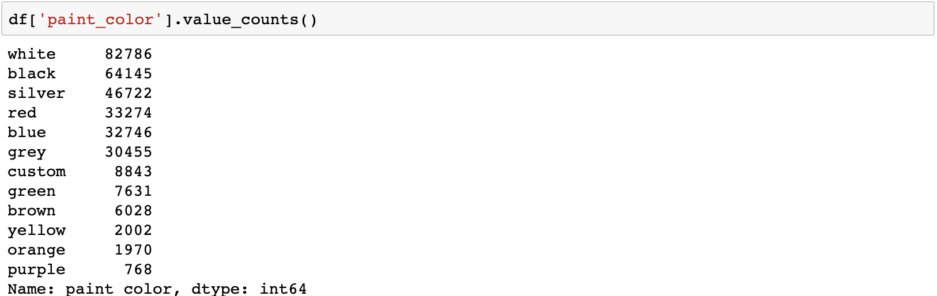
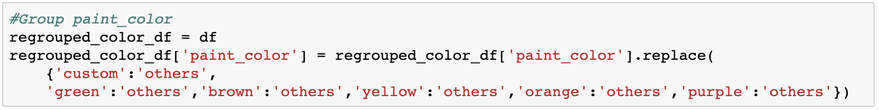
EDA – Car paint color
We group the some of the colors with less counts

Slide 12
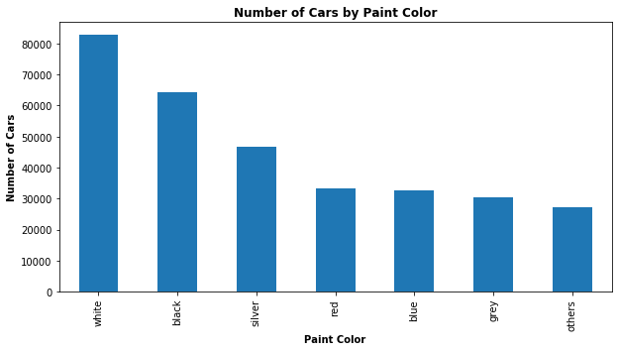
EDA – Number of cars by paint color

Slide 13
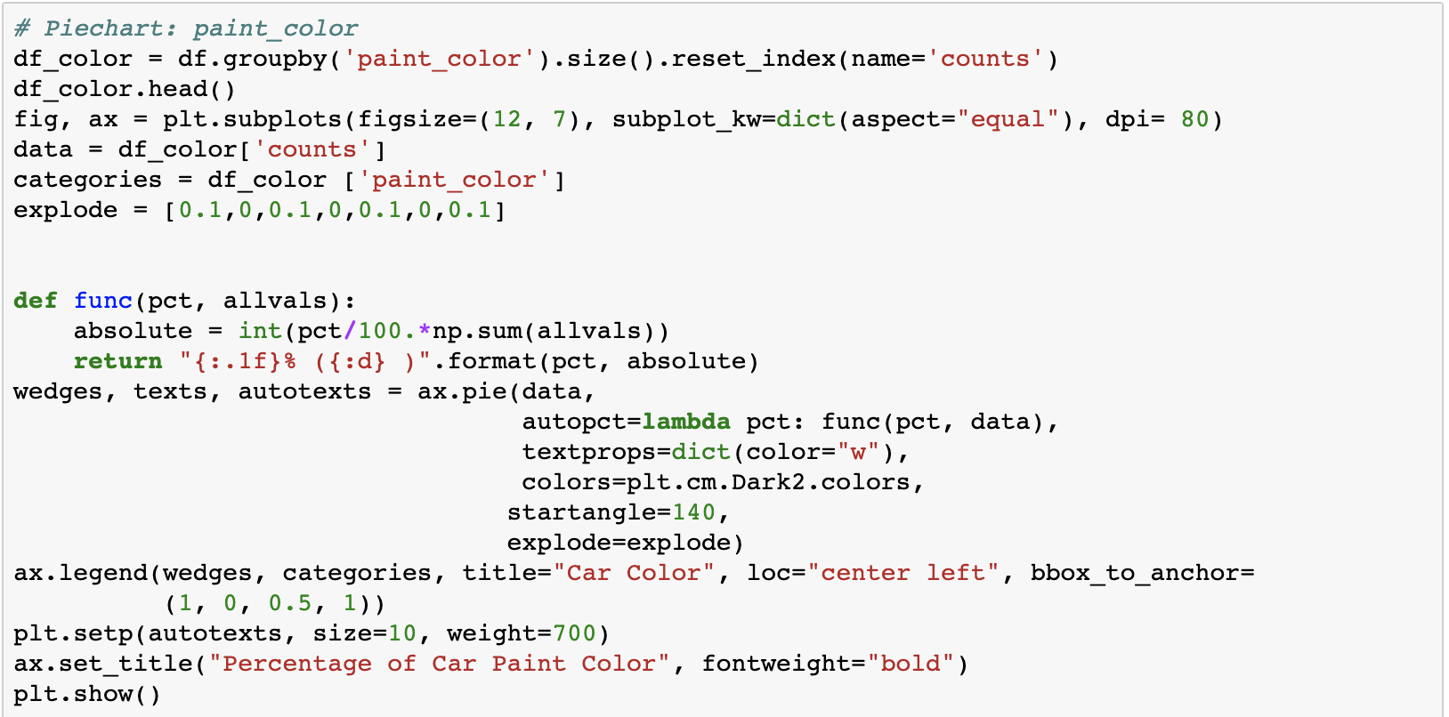
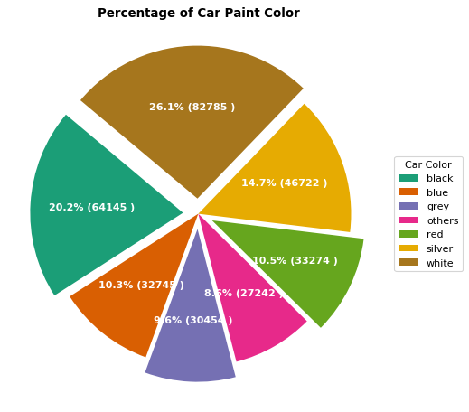
EDA – Car paint color percentage

Slide 14
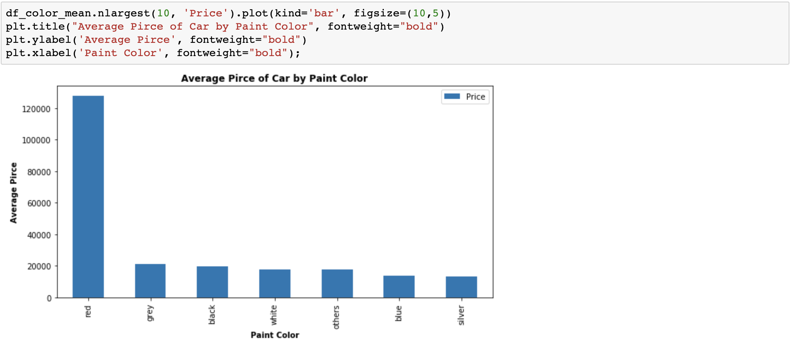
EDA – Ave car price by paint color
Red cars have unreasonable higher average prices.

Slide 15
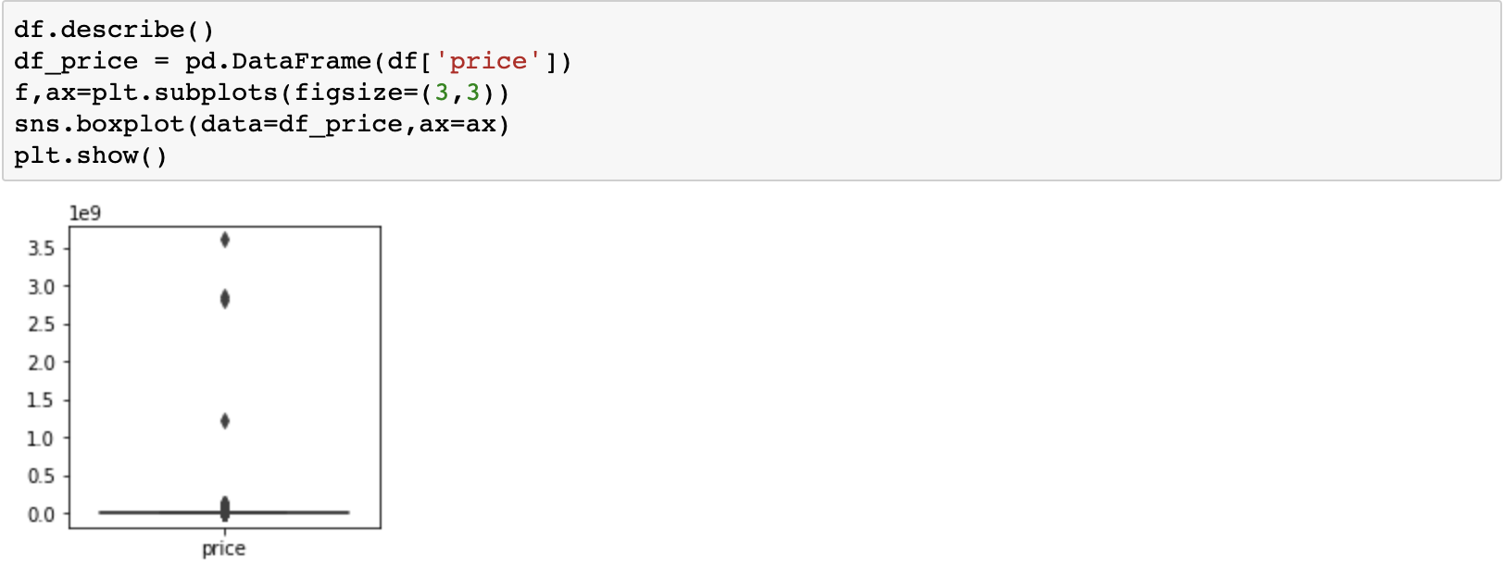
EDA – Car paint color
The boxplot of price shows that we have some outliers

Slide 16
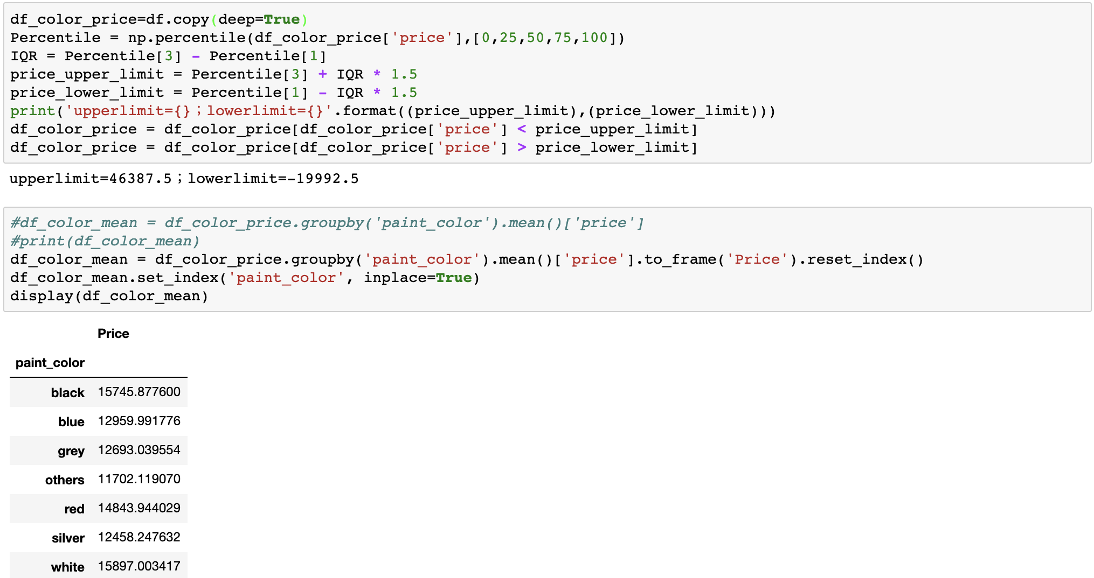
EDA – Car paint color
We cleared the outliers of the prices.

Slide 17
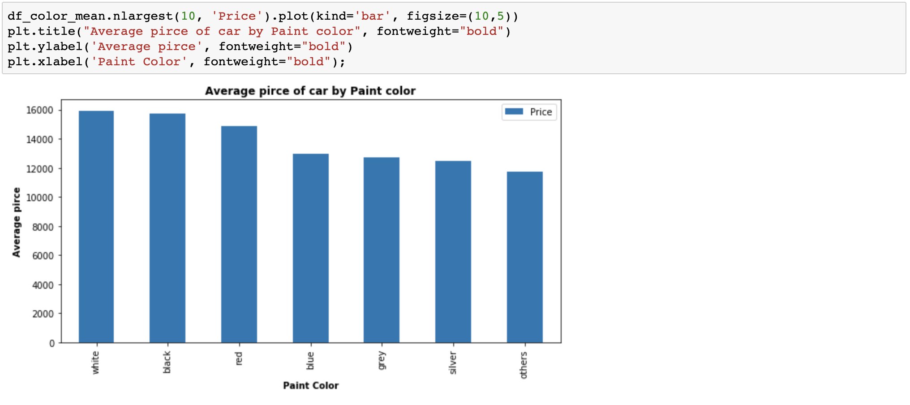
EDA – Avg car price by paint color
Average price difference exists among different paint colors

Slide 18
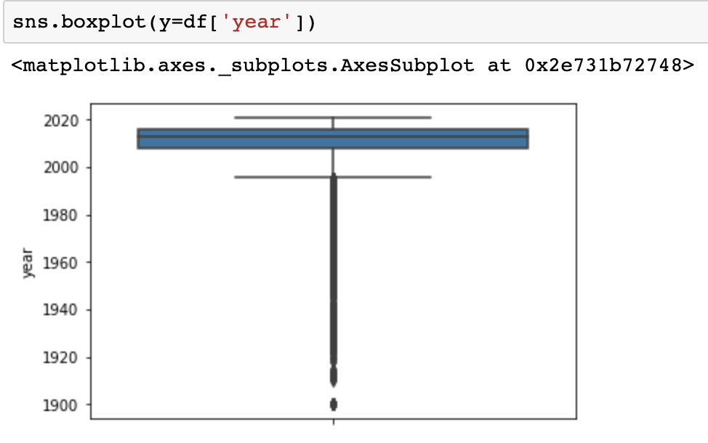
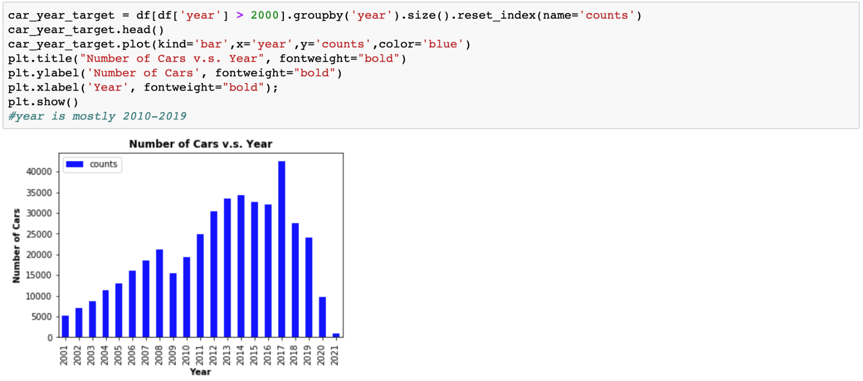
EDA – Number of Cars vs Year
Years are mostly between 2010 and 2019.
2017 ranks the highest among the years.

Slide 19
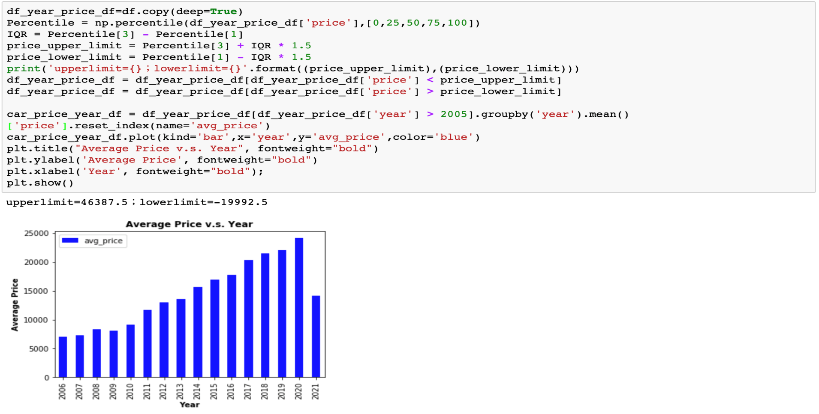
EDA – Year (Avg. price v.s. Year)
Year of the car obviously and reasonably has impact on the average price

Slide 20
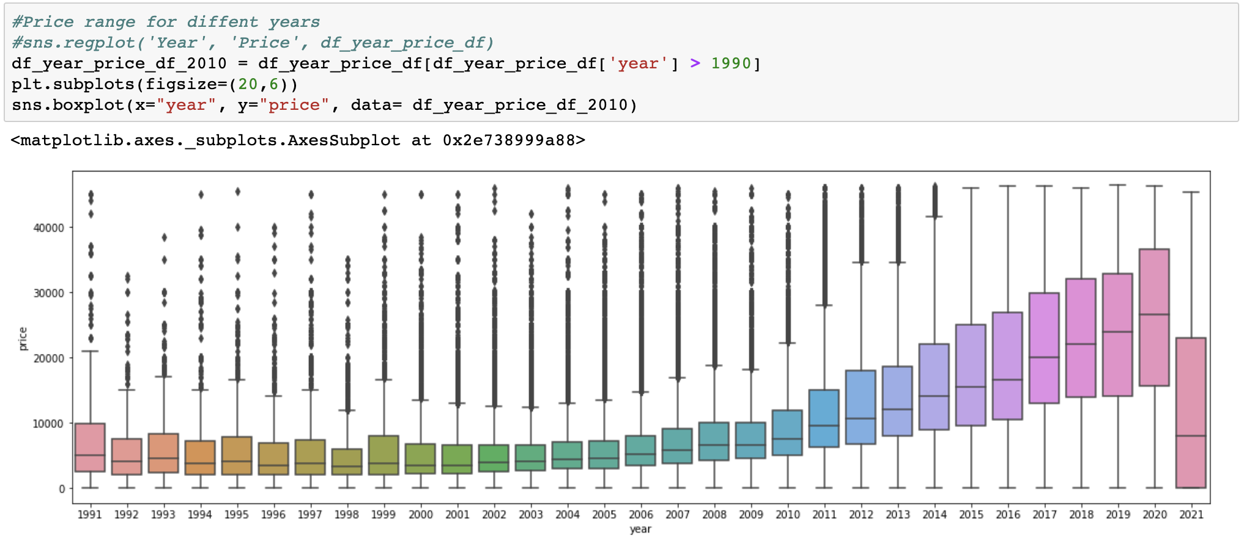
EDA – Price range for different years
Notes:
Note that: we already change N/A to year mean.

Slide 21
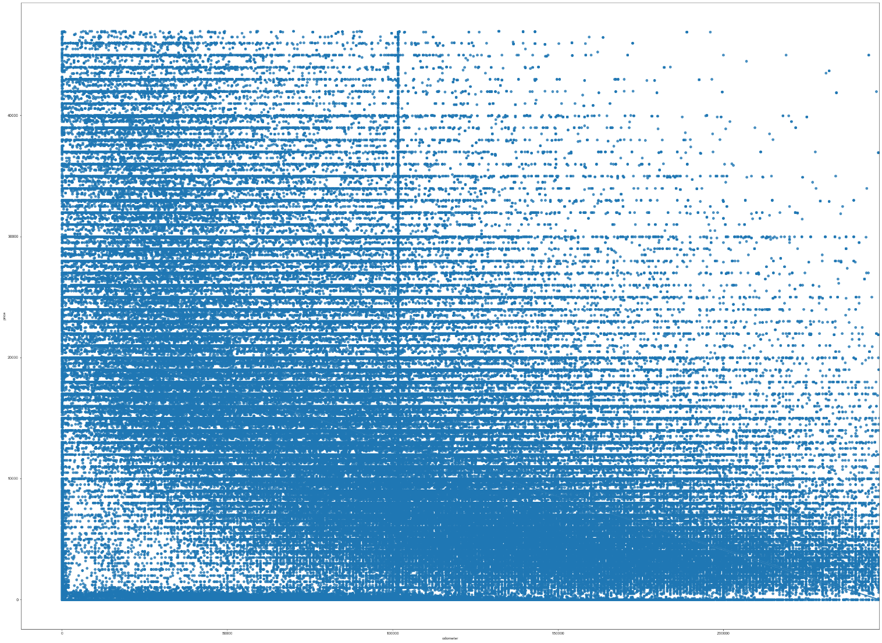
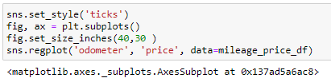
EDA – Mileage
There is a negative relationship between mileage and price

Slide 22

Agenda
Business Problem
Explore Data Analysis
System Demo
Result & conclusion

Slide 23







The factors included in the Price Recommendation System

Slide 24
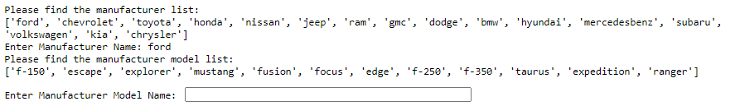
System Demo
ford
f-150

Slide 25
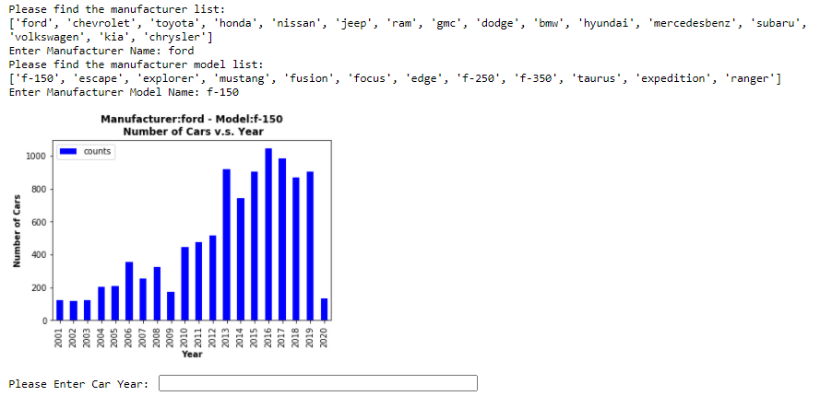
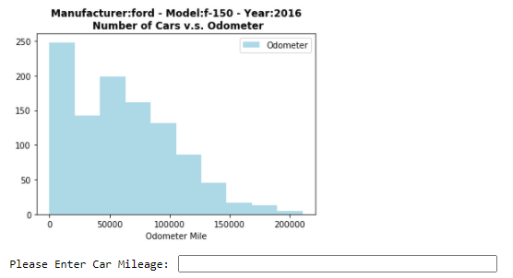
System Demo - Continue
Ford (f-150): number of cars v.s. years
Ford (f-150): number of cars v.s. Odometer in 2016
2016
50000

Slide 26
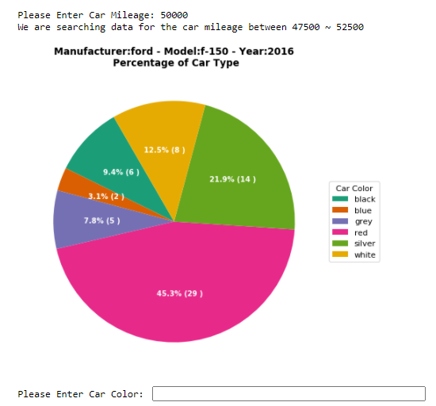
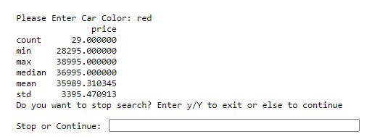
System Demo - Continue
Ford (f-150): percentage of car type in 2016
y
red

Slide 27
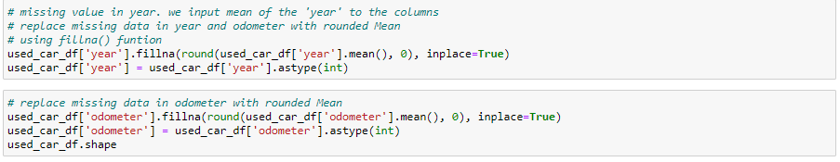
Process the missing data
Process Missing Data
Clear Outlier
Build up Manufacture & Model Dictionary
Prepare Calculation
& Graphic
Get User Input
Print the output
For year and odometer, use
fillna() function to fill the missing data
For manufacturer, model and color, use notna() function to drop missing data

Slide 28
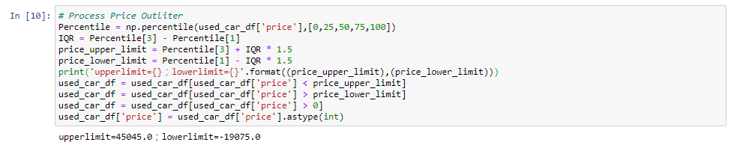
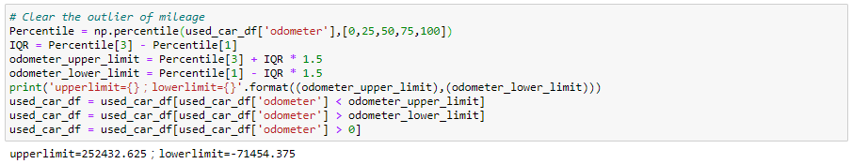
Clear the outlier of price and mileage
Process Missing Data
Clear Outlier
Build up Manufacture & Model Dictionary
Prepare Calculation
& Graphic
Get User Input
Print the output
Use IQR to process the outlier of the data

Slide 29
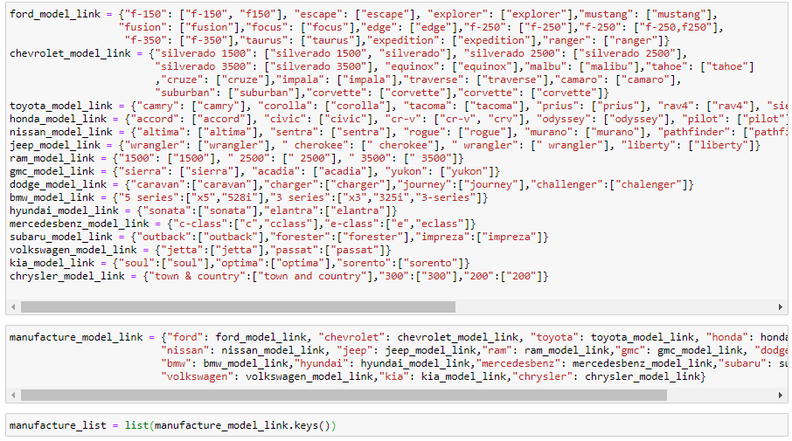
Build up Manufacture & Model Dictionary
Process Missing Data
Clear Outlier
Build up Manufacture & Model Dictionary
Prepare Calculation
& Graphic
Get User Input
Print the output

Slide 30
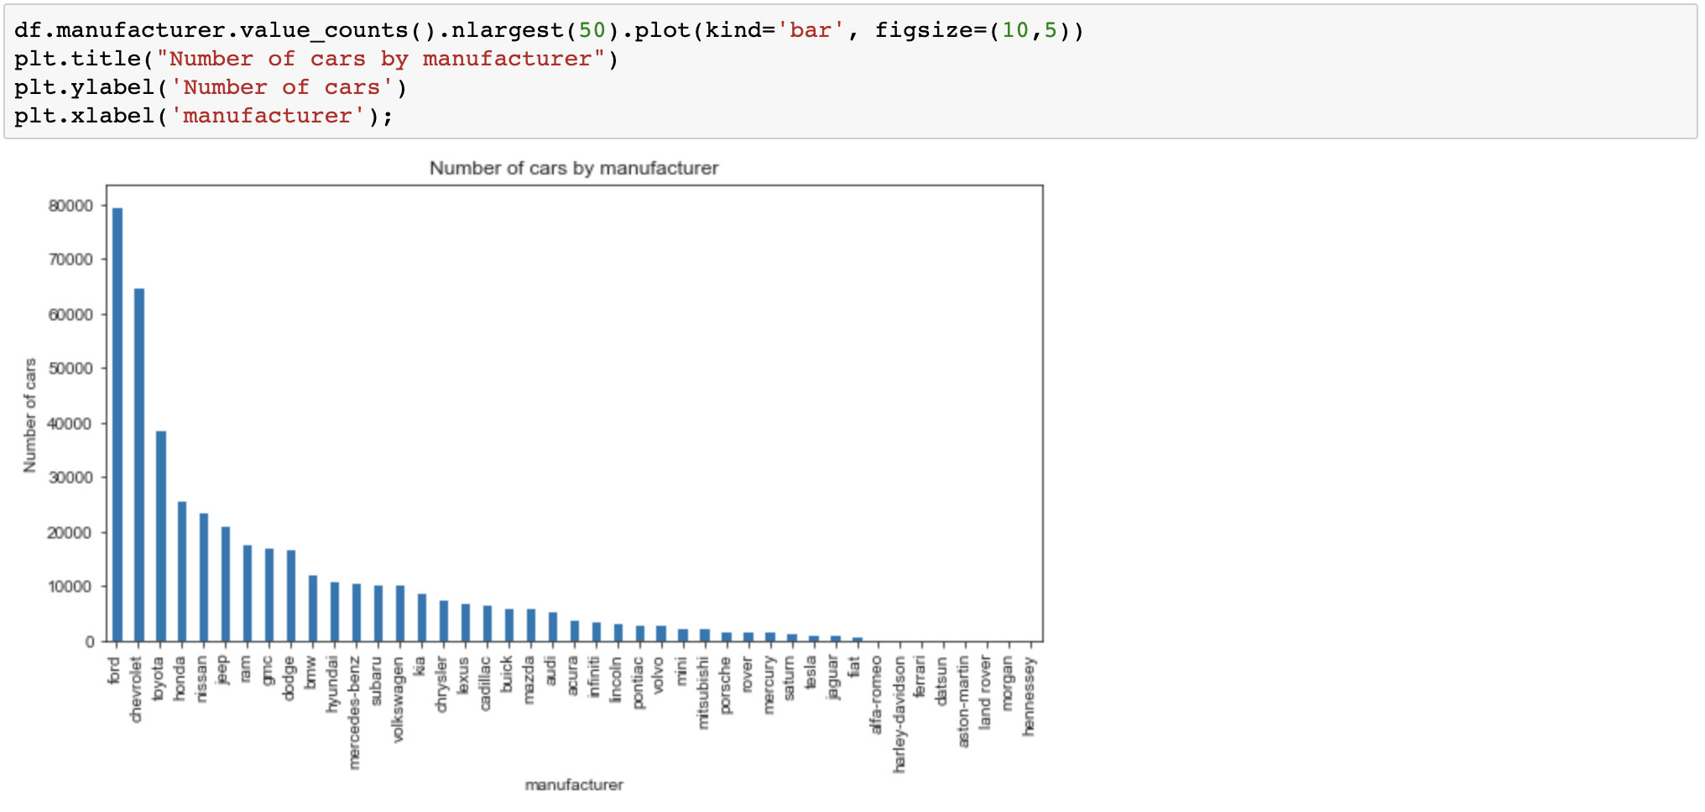
Car manufacturer by counts
Process Missing Data
Clear Outlier
Build up Manufacture & Model Dictionary
Prepare Calculation
& Graphic
Get User Input
Print the output
Top 3 Manufacturers:
Ford
Chevrolet
Toyota

Slide 31
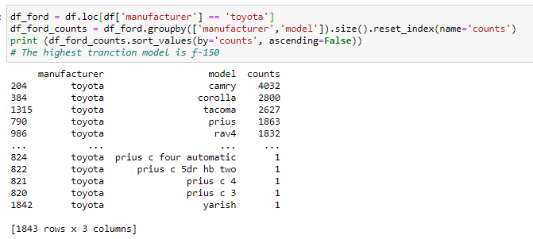
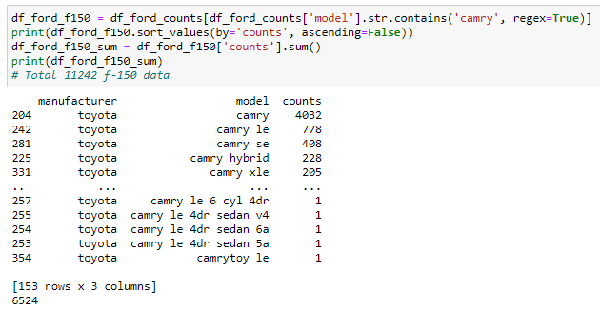
Manufacturer and model list
Process Missing Data
Clear Outlier
Build up Manufacture & Model Dictionary
Prepare Calculation
& Graphic
Get User Input
Print the output
Which manufacturers and models we include? What’s the criteria?
Use groupby() function to filter data and find out the count number of manufacturers and models
We chose those models with more than 1000 counts to be included in our model

Slide 32
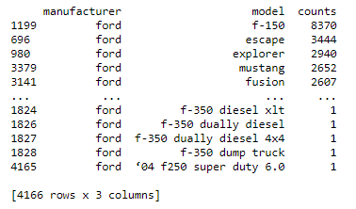
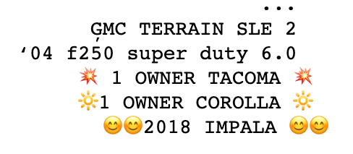
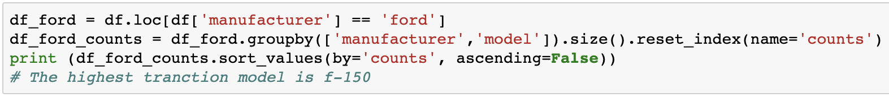
Messy data of model column
Process Missing Data
Clear Outlier
Build up Manufacture & Model Dictionary
Prepare Calculation
& Graphic
Get User Input
Print the output
Later on, we use str.contains() to filter the column of models

Slide 33
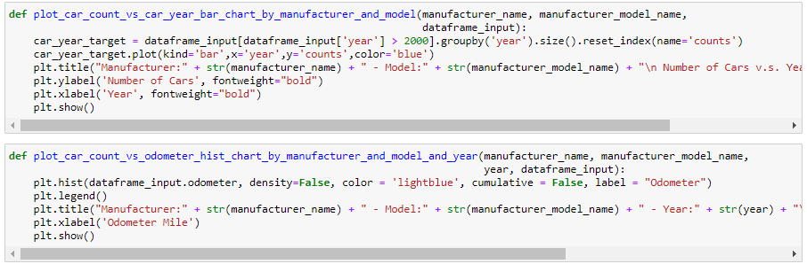
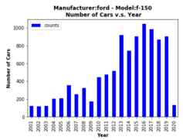
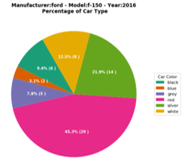
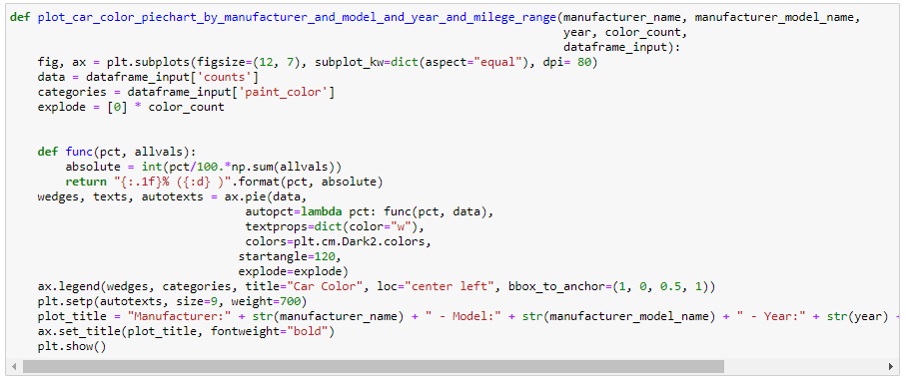
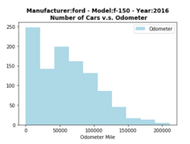
Prepare Calculation & Graphic
Process Missing Data
Clear Outlier
Build up Manufacture & Model Dictionary
Prepare Calculation
& Graphic
Get User Input
Print the output

Slide 34
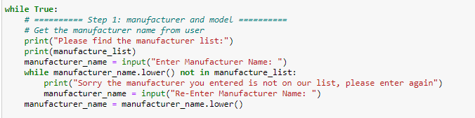
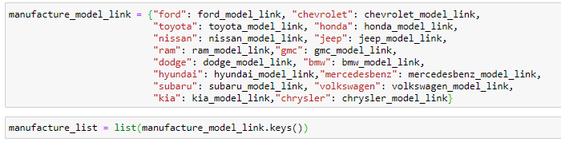
Get User Input
Process Missing Data
Clear Outlier
Build up Manufacture & Model Dictionary
Prepare Calculation
& Graphic
Get User Input
Print the output
Take Manufacturer for example
Use input() function to get user input
Use while loop to prevent type in error and .lower() to include both uppercase and lowercase of the input

Slide 35
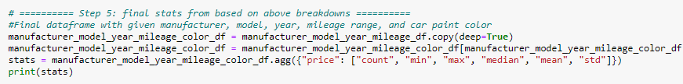
Print the output
Process Missing Data
Clear Outlier
Build up Manufacture & Model Dictionary
Prepare Calculation
& Graphic
Get User Input
Print the output
Manufacturer
Model
Year
Mileage
Color
Use pandas.DataFrame.agg function to do the calculation

Slide 36
Agenda
Business Problem
Explore Data Analysis
System Demo
Result & conclusion

Slide 37

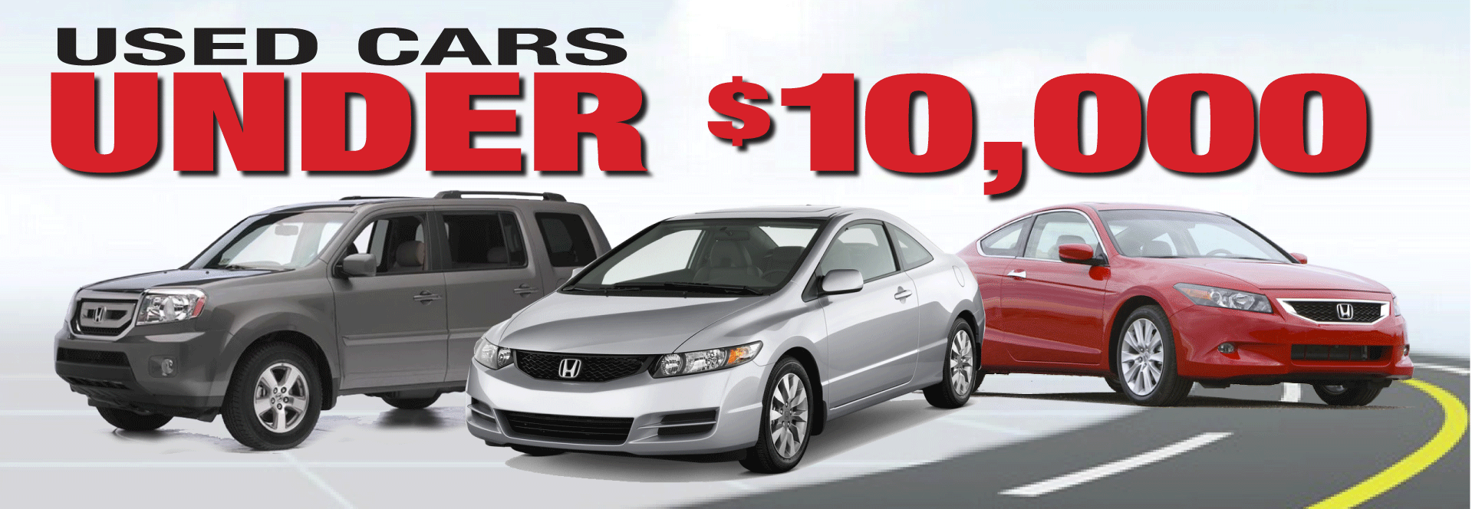
Result & Conclusion
Faster to find price range
Easier to set competitive price
Attract more customers and expand the business
Notes:
With this new price recommendation system we built, the car dealers are able to find an appropriate price range for a used car immediately based on its manufacturer, model, mileage, etc.
Then it becomes easier for the car dealers to set a competitive but also profitable price for the used car to attract more customers and expand the business.

Slide 38

Q and A?

Slide 39
Dataset & Reference
https://github.com/AustinReese/UsedVehicleSearch
https://www.statista.com/statistics/183713/value-of-us-passenger-cas-sales-and-leases-since-1990/

Slide 40
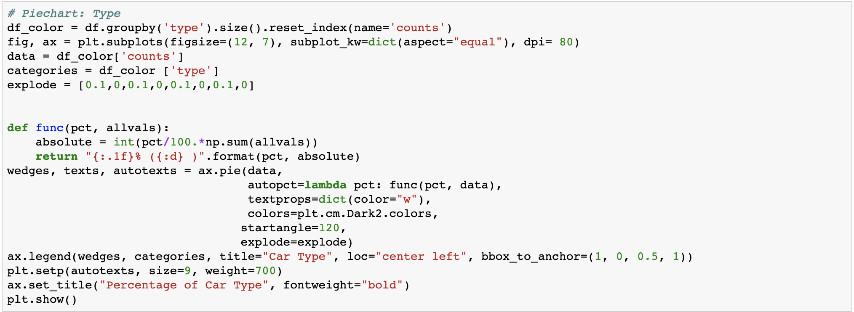
Appdenix – Car type pie chart code

Slide 41
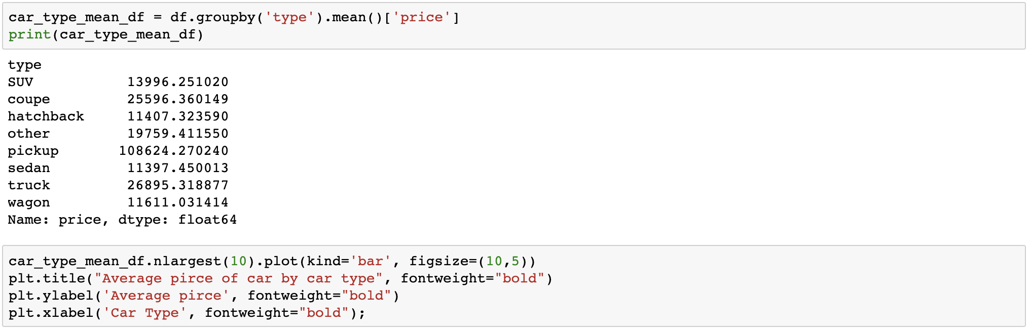
Appdenix – Avg car type mean code

Slide 42
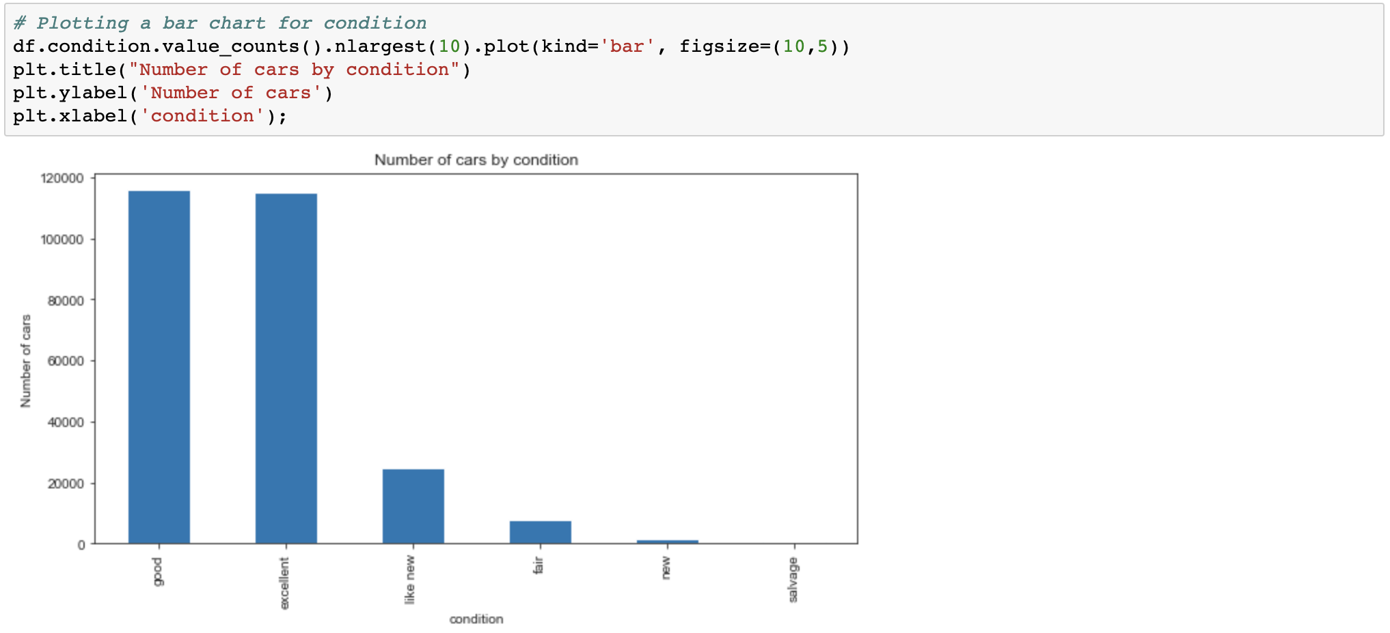
Appdenix – EDA Condition

Slide 43
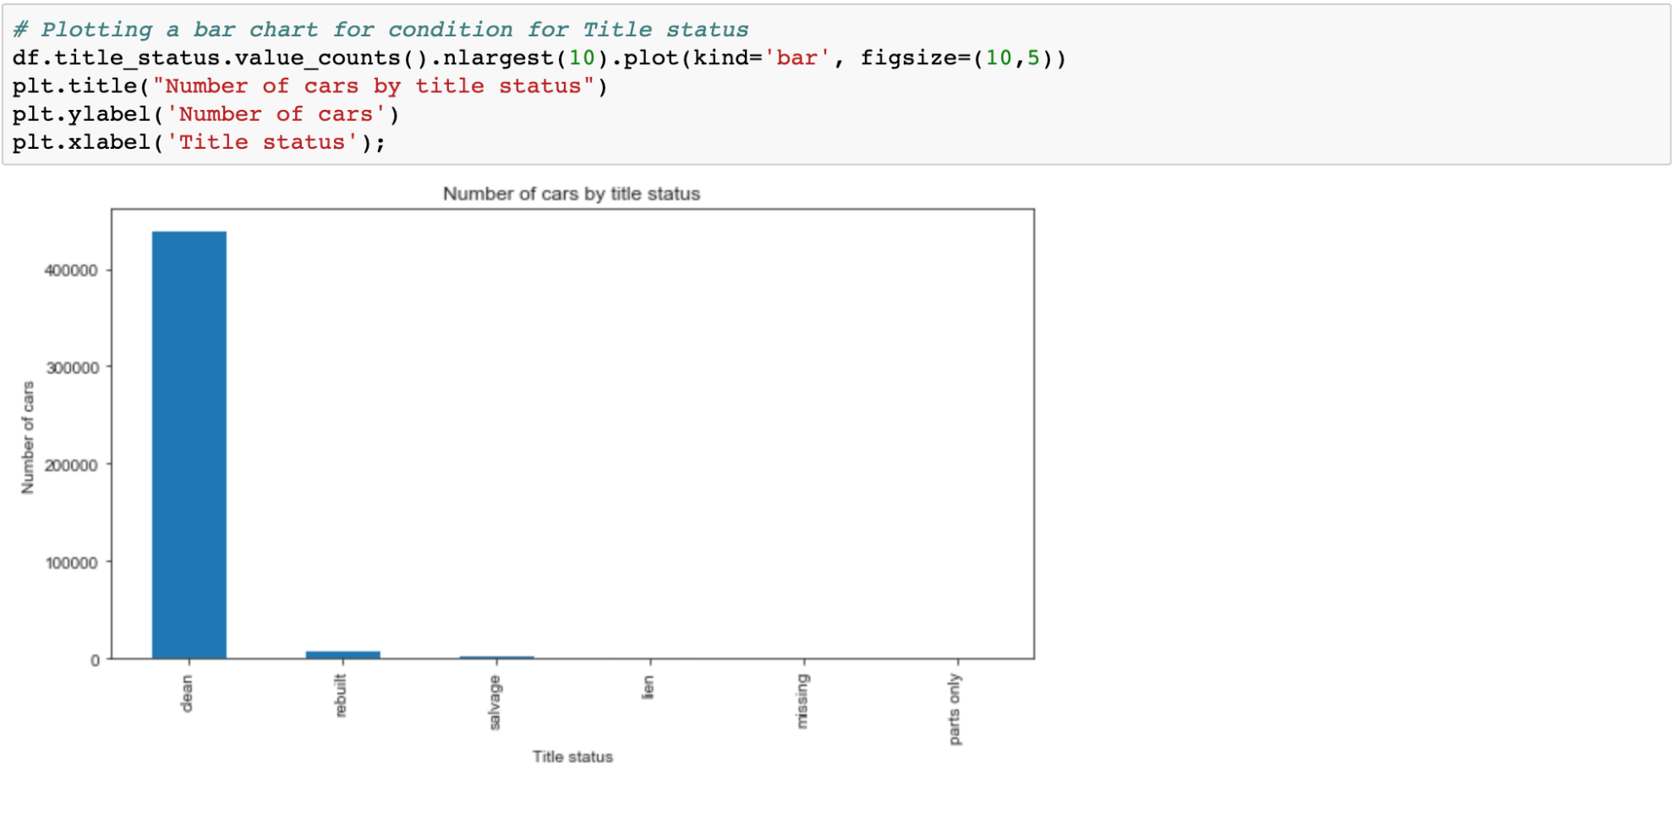
Appdenix – EDA Condition

Slide 44
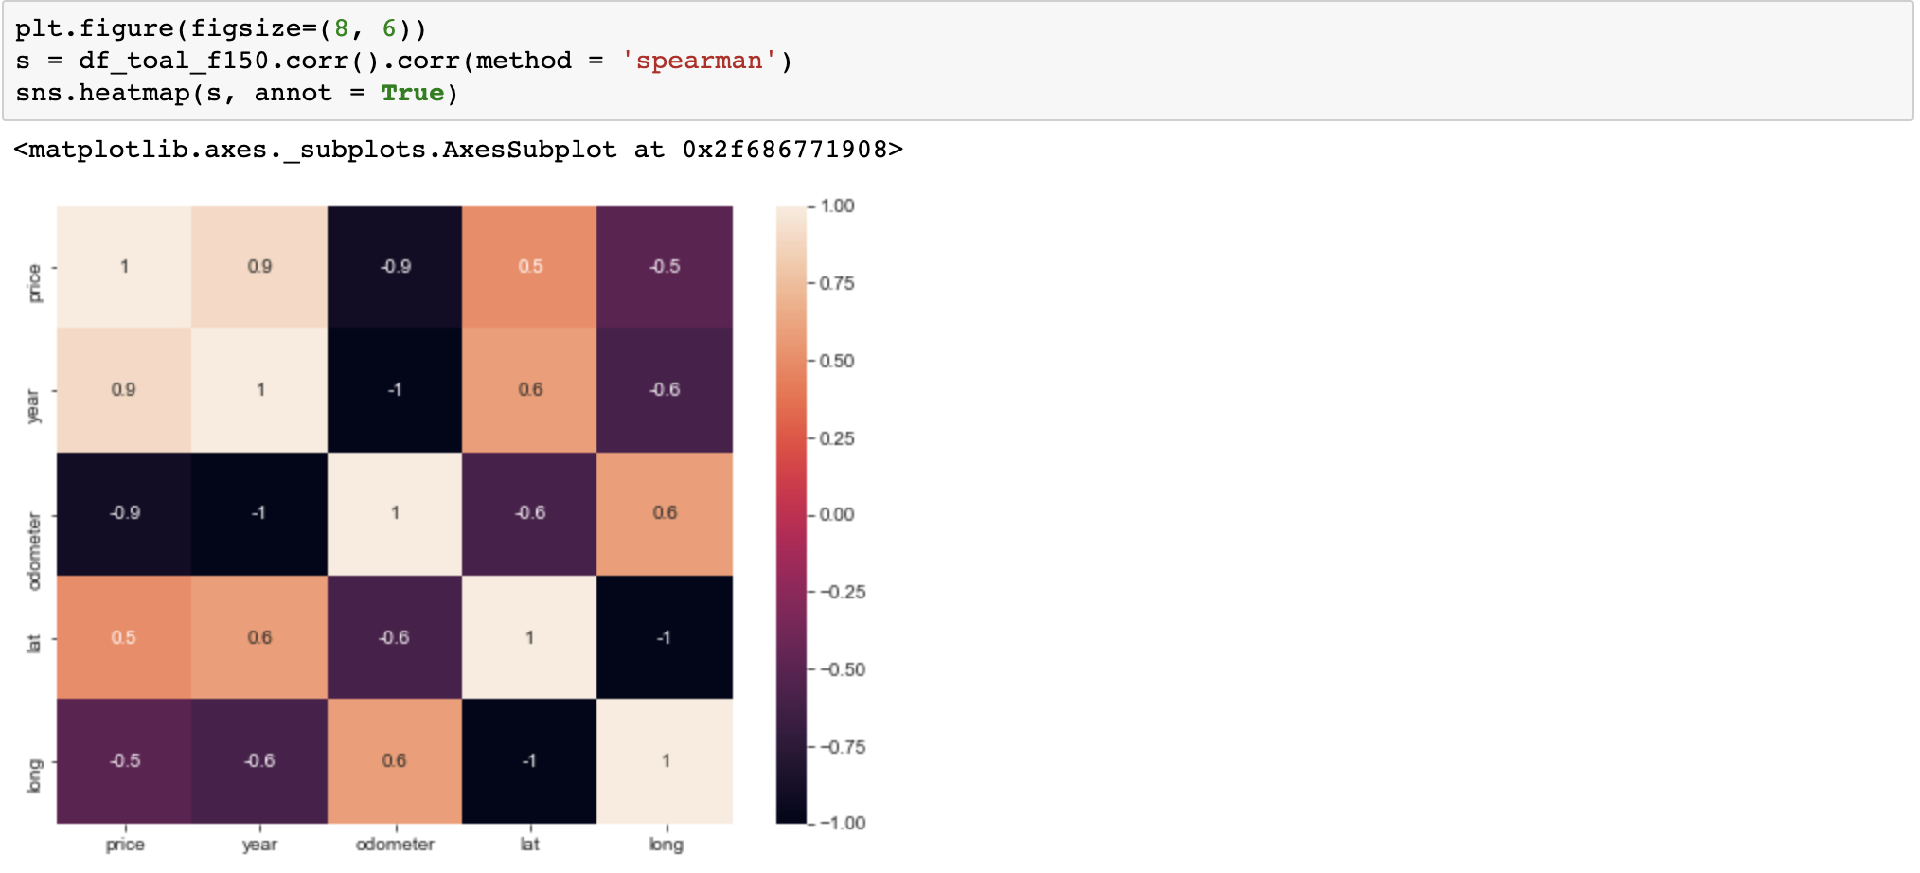
Appdenix - Correlation

